Slide 1

Build-your-own Microcontroller Sensor Workshop

Slide 2
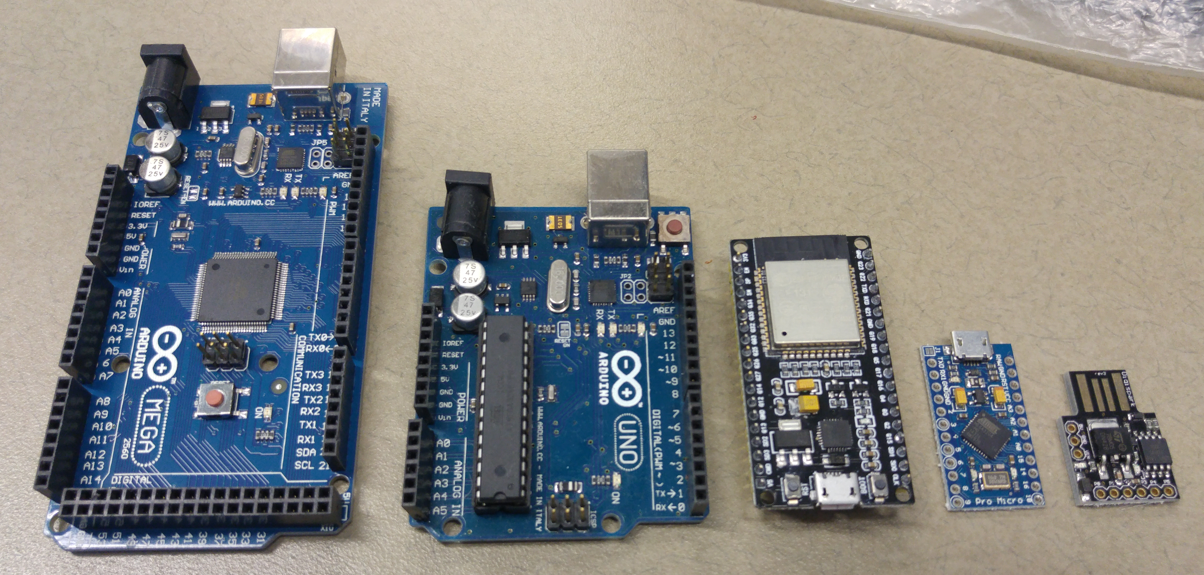
Microcontrollers for all needs…
~$8-9
~$4-5
~$4-5
~$1-2

Slide 3
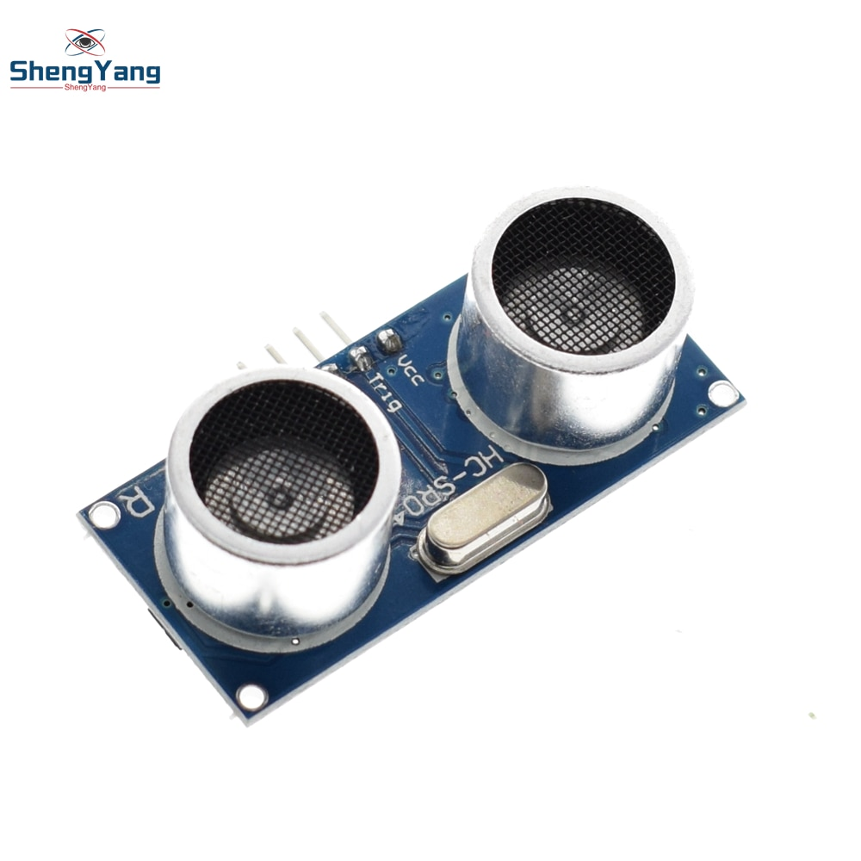
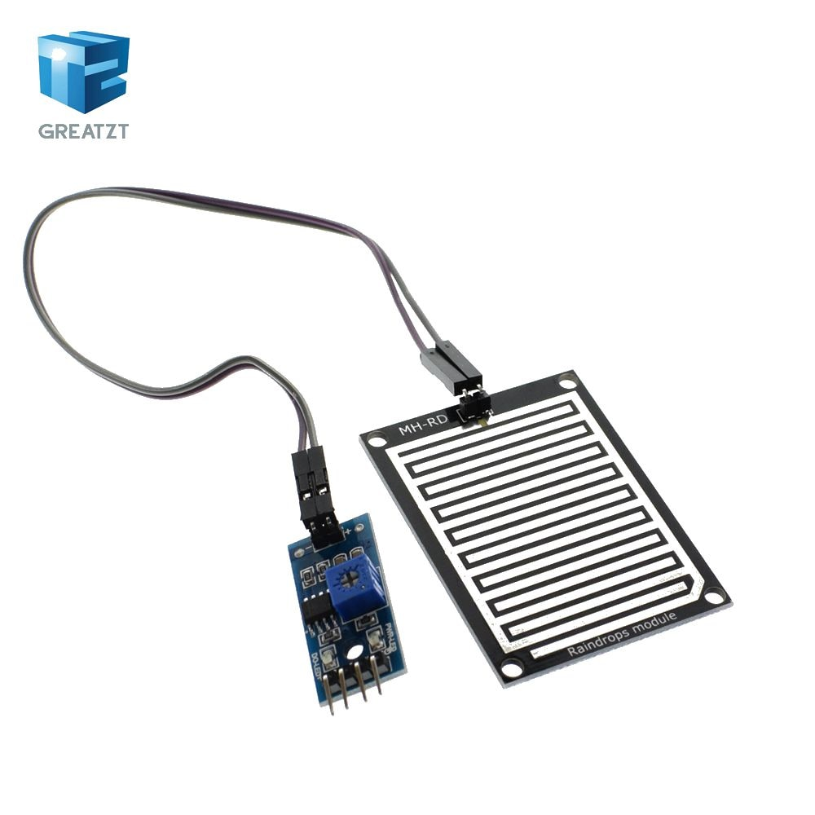
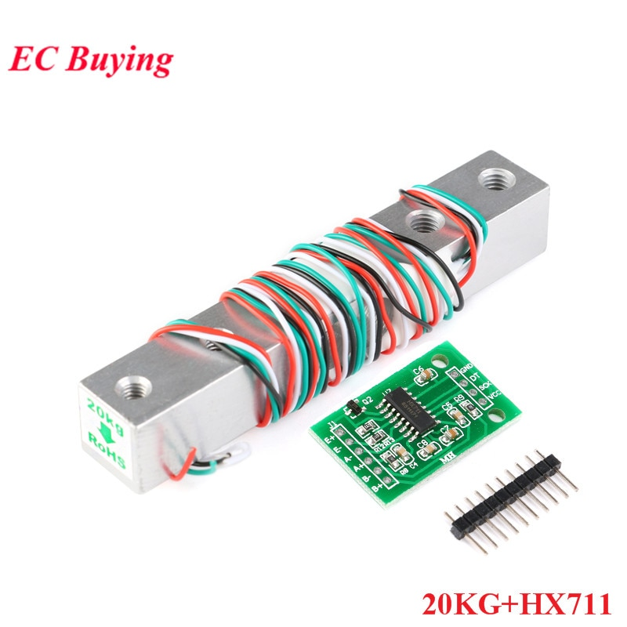
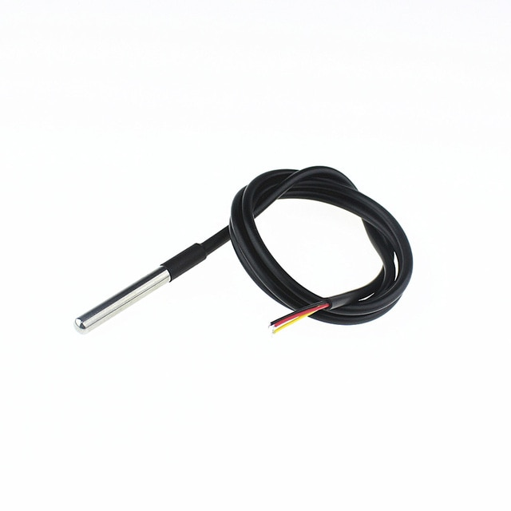
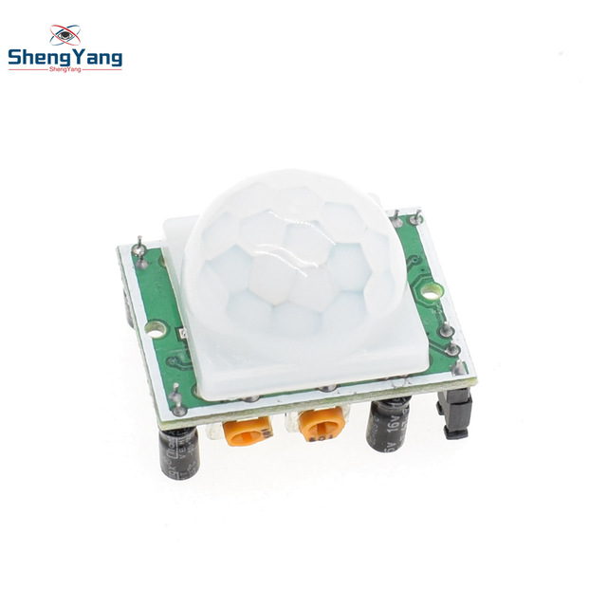
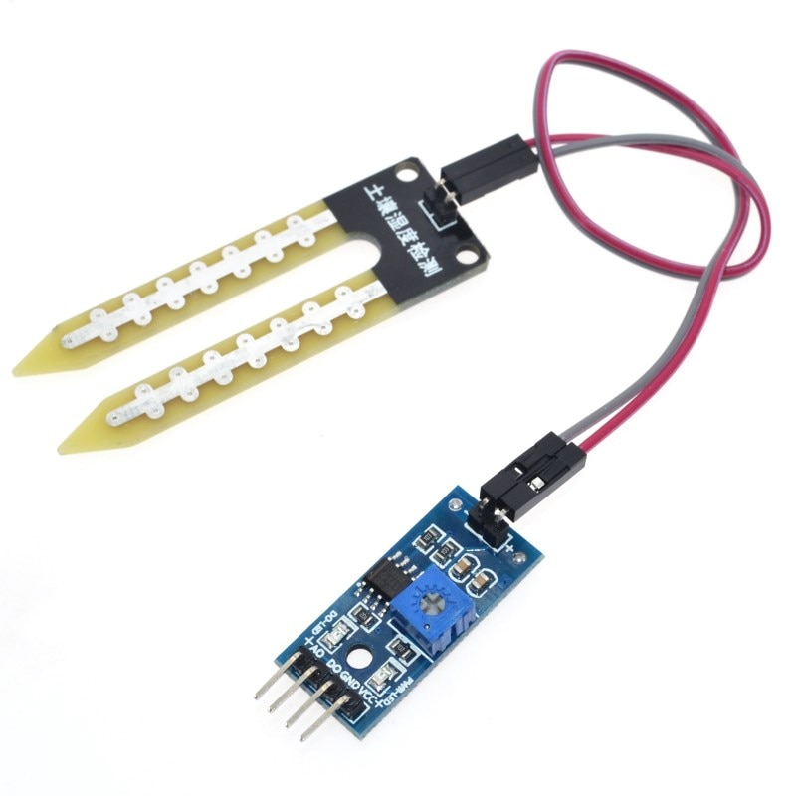
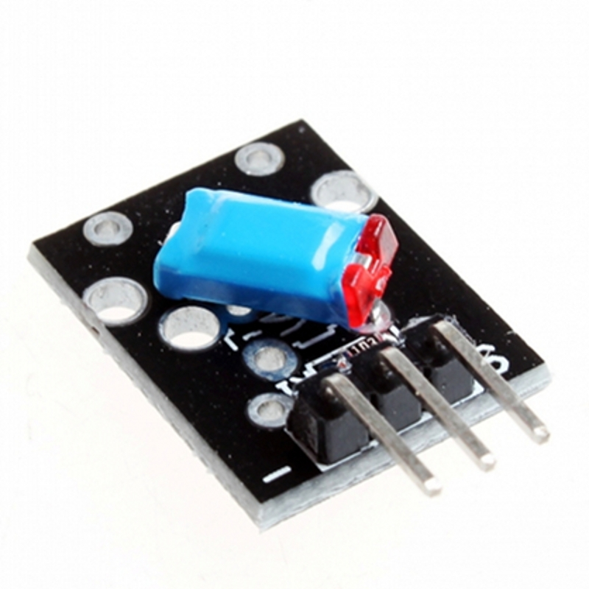
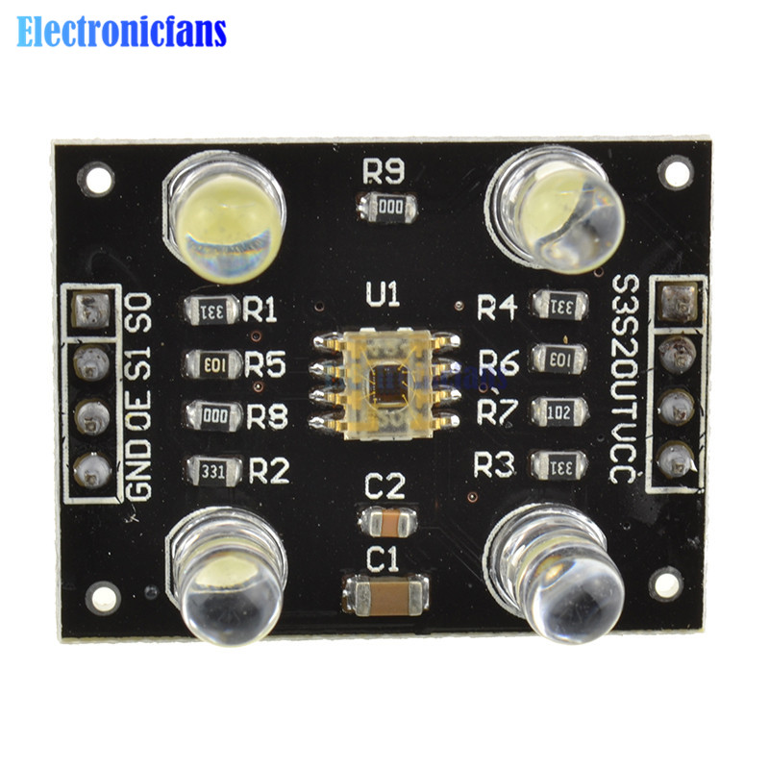
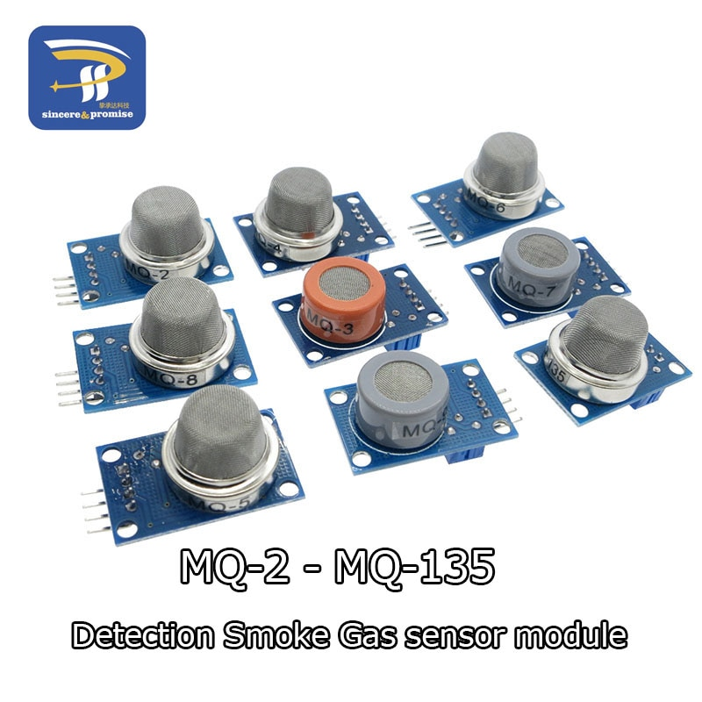
Sensors of all types…

Slide 4
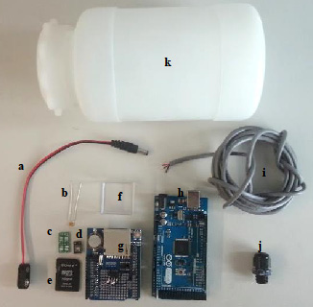
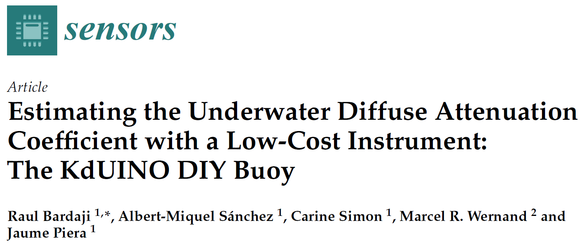
Example coastal and marine applications…

Slide 5
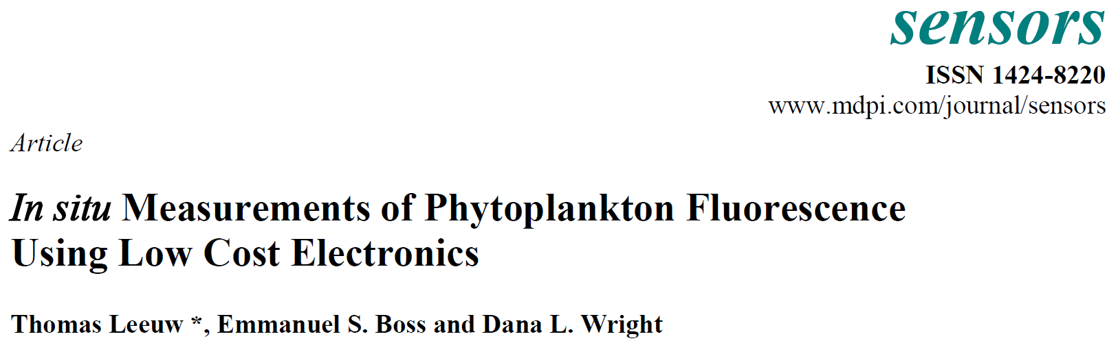
Example coastal and marine applications…

Slide 6
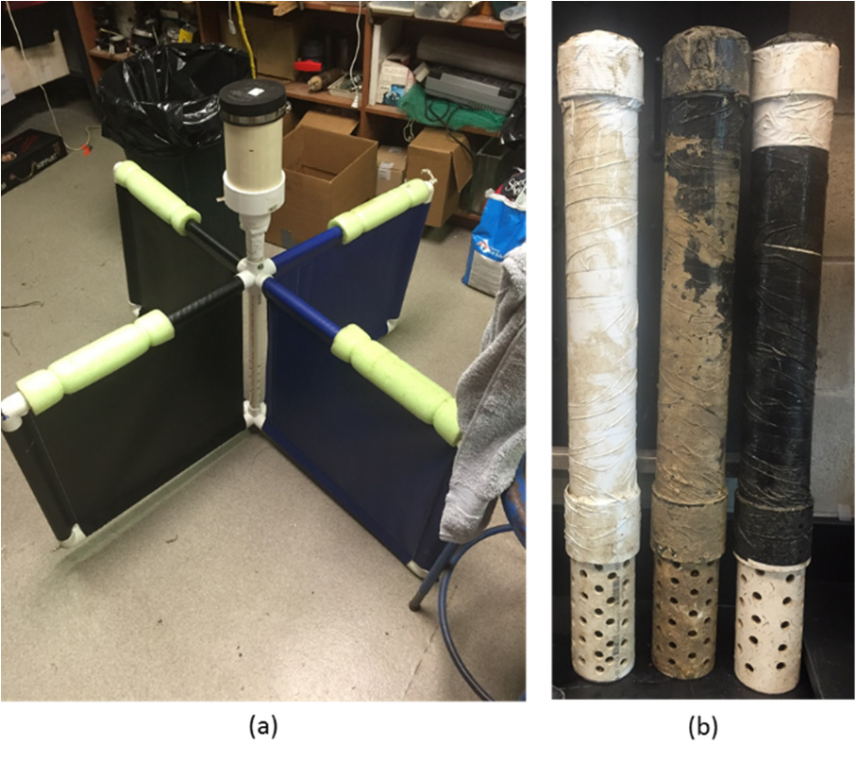
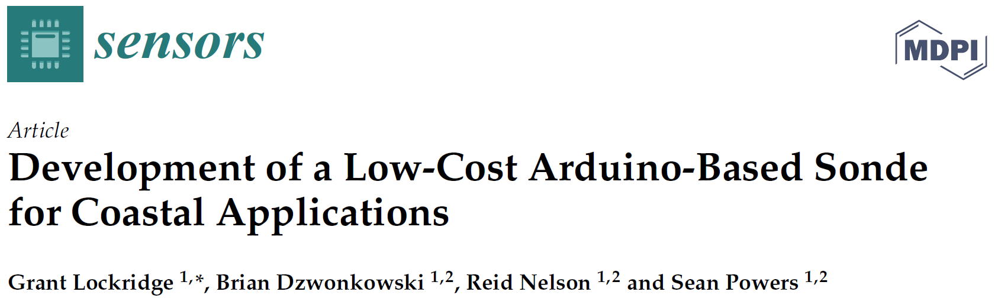
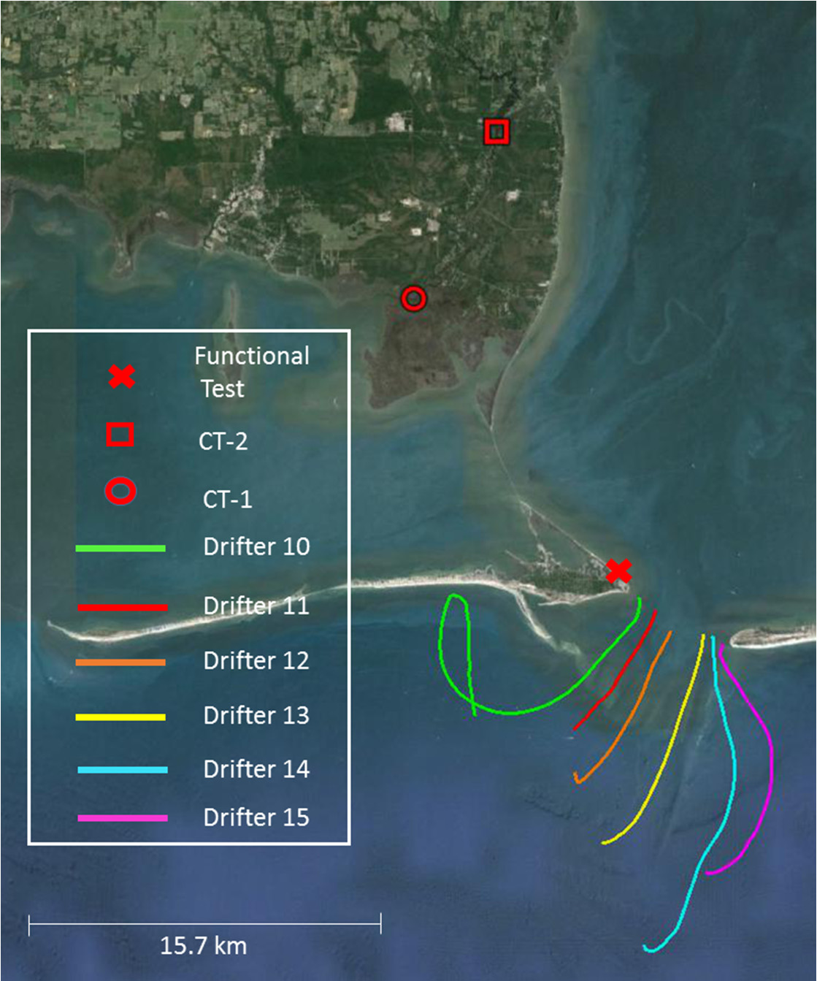
Example coastal and marine applications…

Slide 7
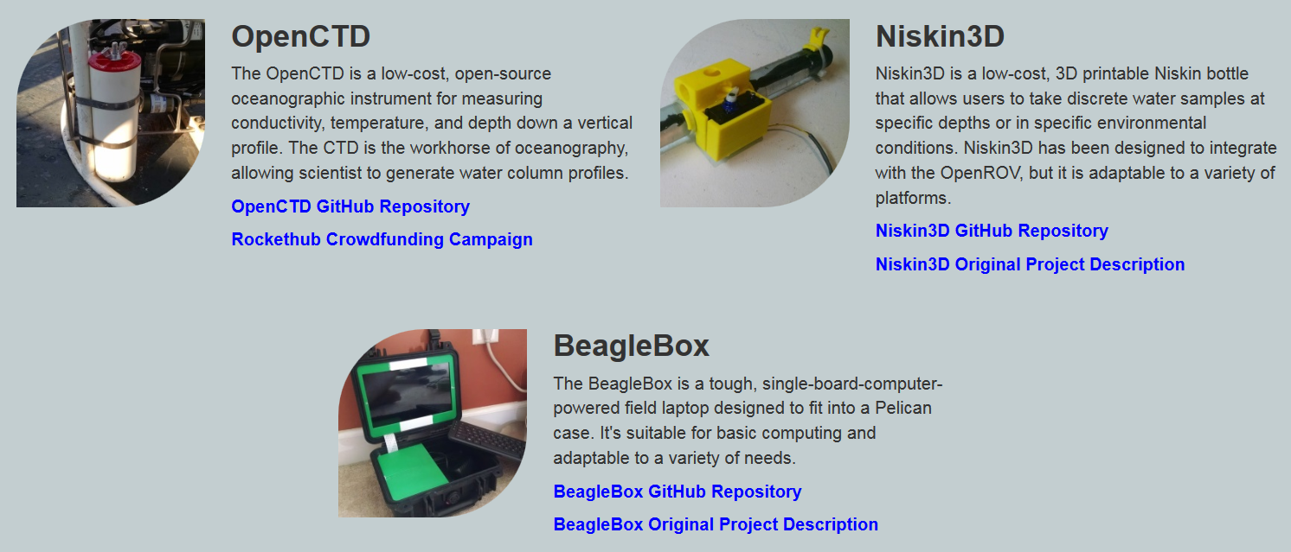
Example coastal and marine applications…
Oceanography for Everyone (http://www.oceanographyforeveryone.com/)

Slide 8
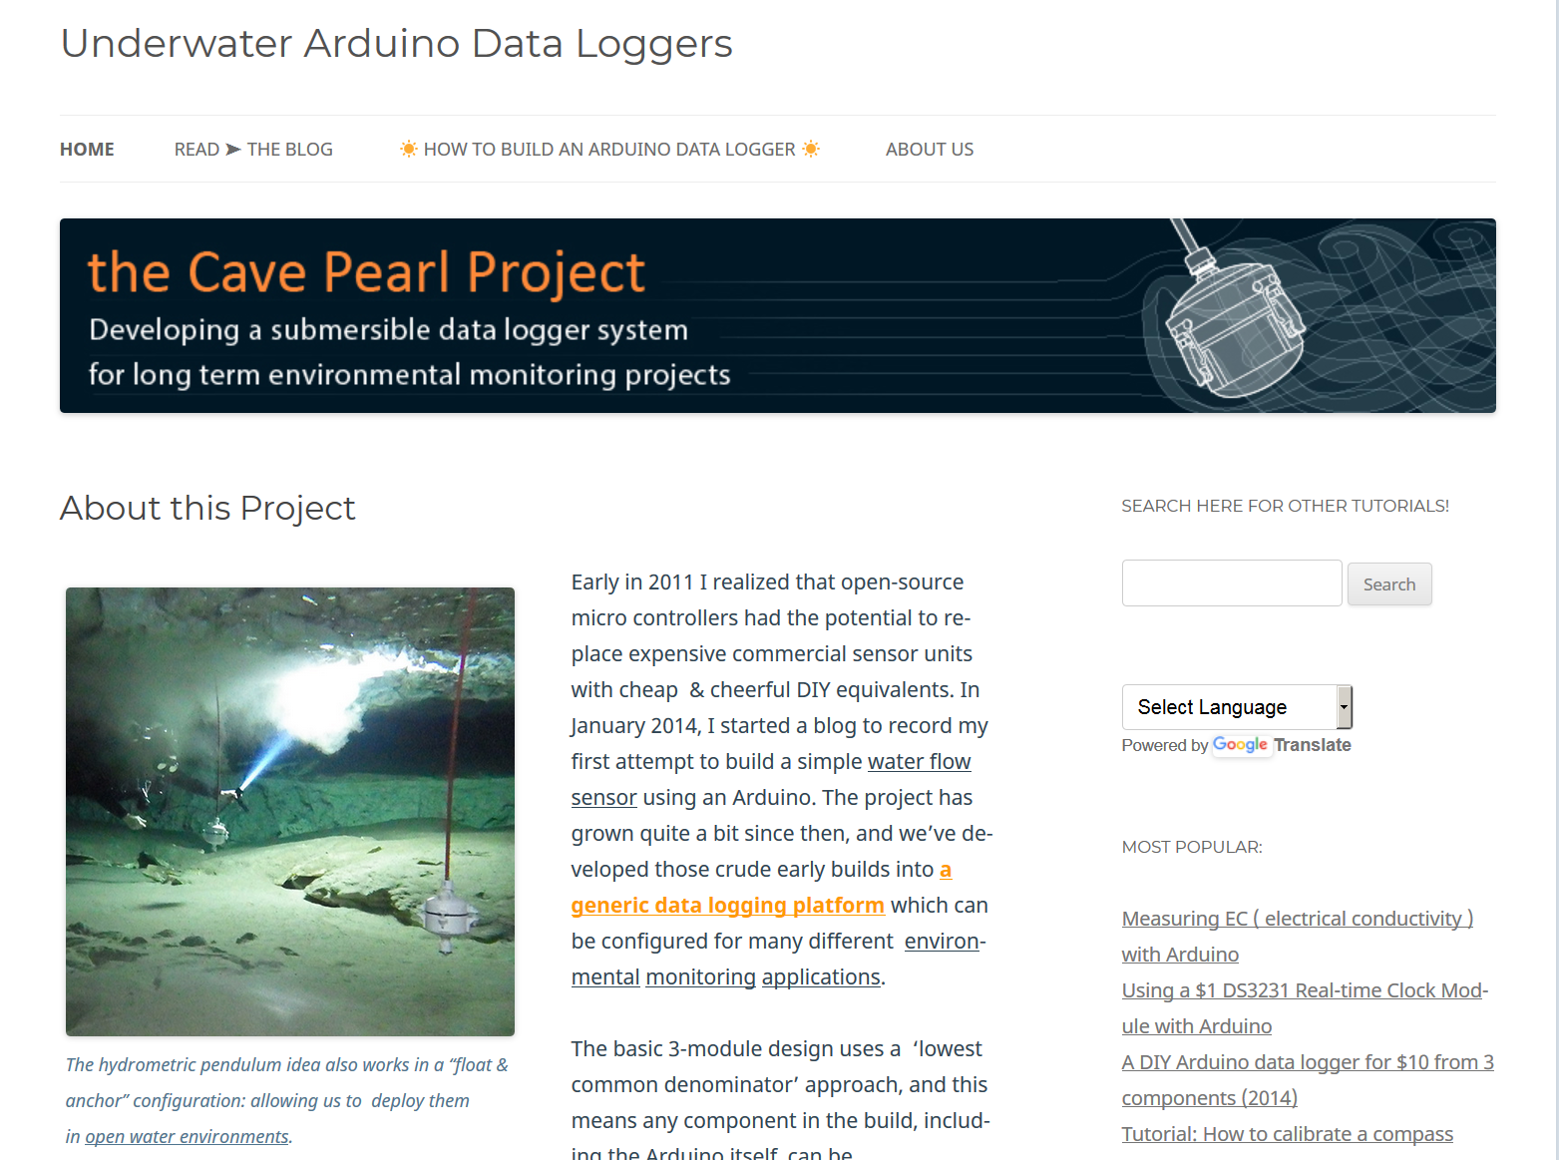
Example coastal and marine applications…
Cave Pearl Project
(https://thecavepearlproject.org/)

Slide 9
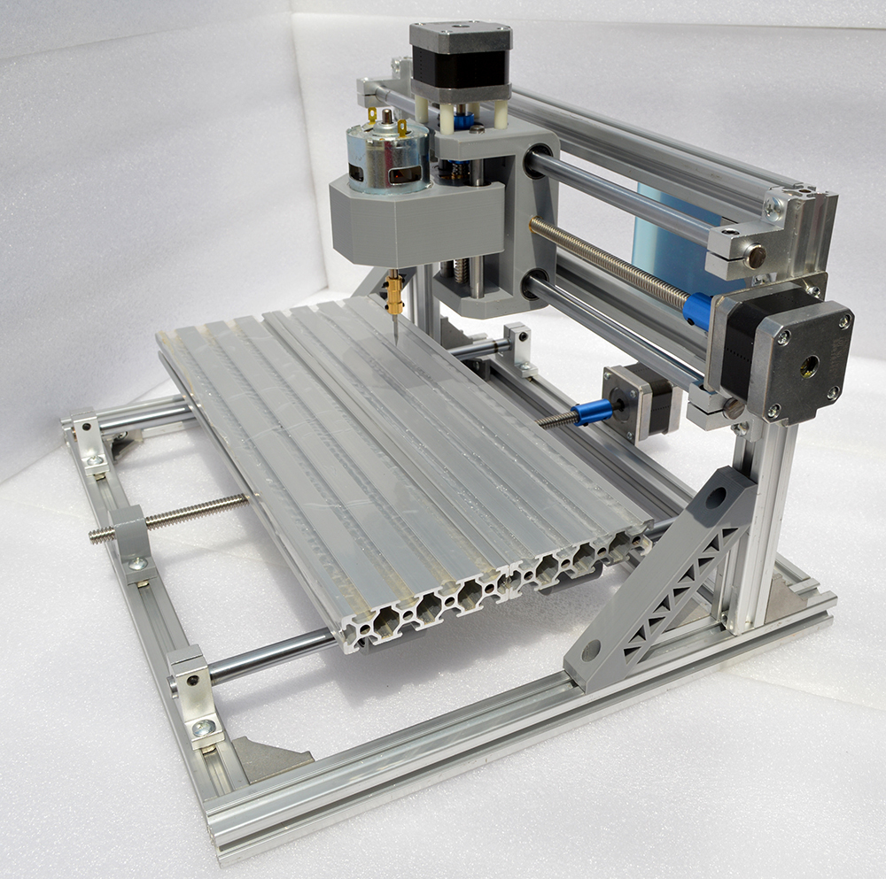
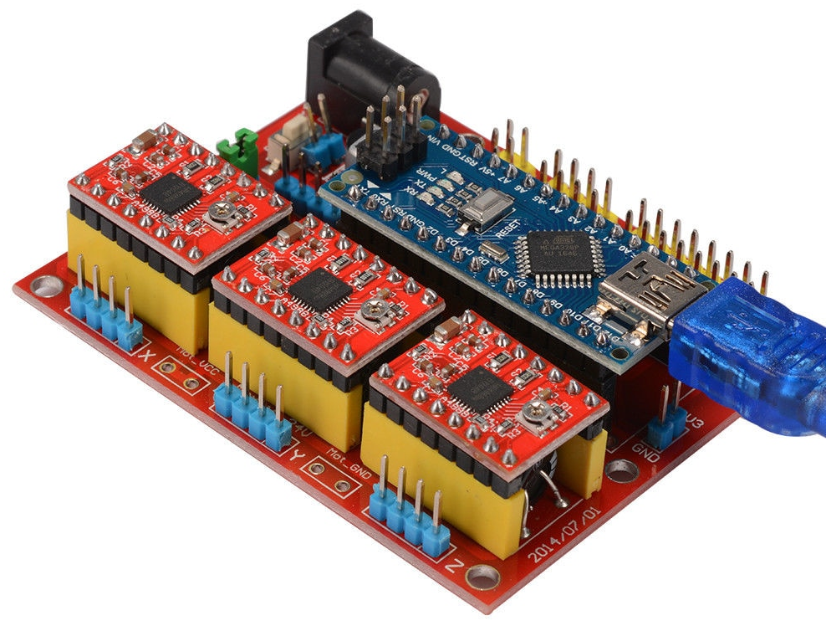
For controlling, too…

Slide 10
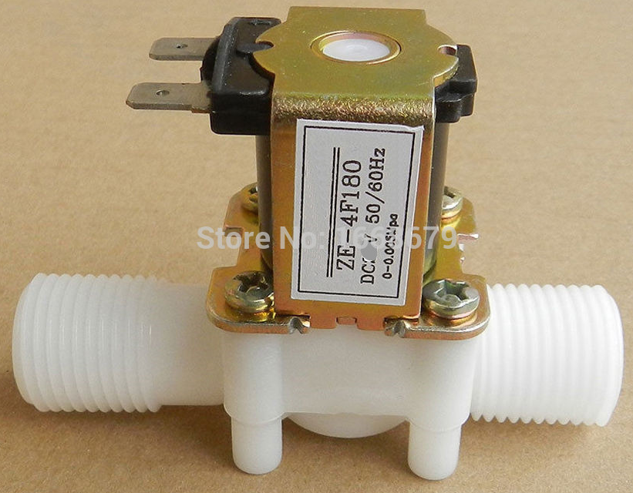
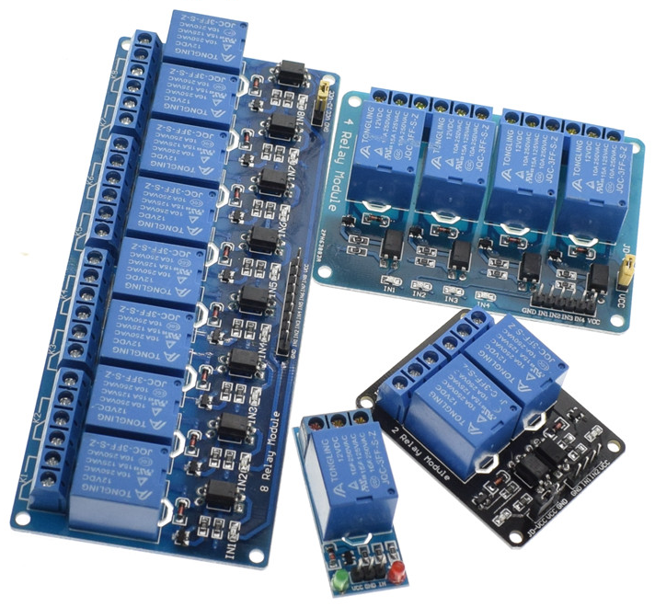
For controlling, too…
Check out OpenSprinkler project!
https://opensprinkler.com/

Slide 11
Other uses
Gather data from lab equipment (microbalances, ovens, other instrumentation)
Automate repetitive processes such as time-lapse photography
Deploy cheap exploratory gear that if lost or damaged is not a major consequence

Slide 12
What applications can you imagine for the lab or field?

